Slide 1

Two Objective Optimization of Longitudinal Navigation Along the Minimum Time curve
Presented to Prof. Daniela Iacoviello
Done by
Luca Tirel tirel.1702631@studenti.uniroma1.it Ali Mohamed Ali Hassan Ali ali.1936023@studenti.uniroma1.it
Notes:
1

Slide 2
Contents
Motivation & literature review.
Model .
Zermelo’s Problem.
Optimal Tracking scheme. 4.1) longitudinal model of aircraft. 4.2) Proposed navigation scheme
Results & Simulations .
Conclusions &Future work .
References.
Contents
Pagina 2
Notes:
2

Slide 3
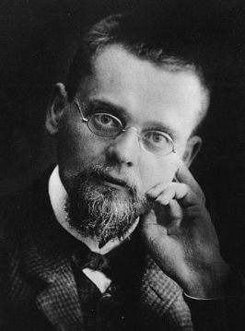
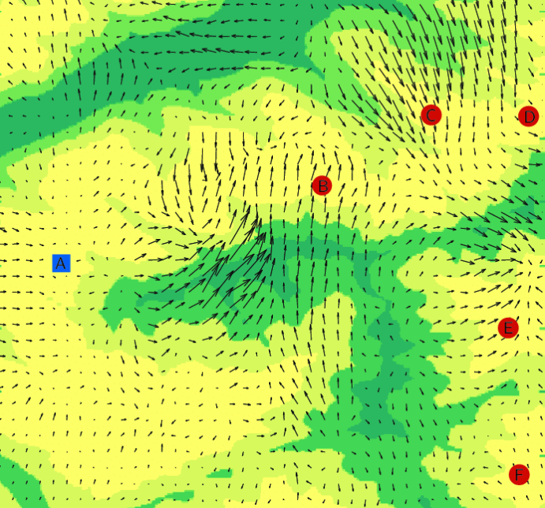
Literature Review
Zermelo’s Navigation Problem In an unbounded plane where the wind distribution is given by a vector field as a function of position and time, a Vehicle moves with constant velocity relative to the surrounding air mass. How must the ship be steered in order to come from a starting point to a given goal in the shortest time? In his 1931 article [1] Ernst Zermelo formulates this problem
Ernst Zermelo
What it the optimal path going from A to other point (B,C,D,E,F) ?
Motivation & literature review
Pagina 3
Notes:
3

Slide 4
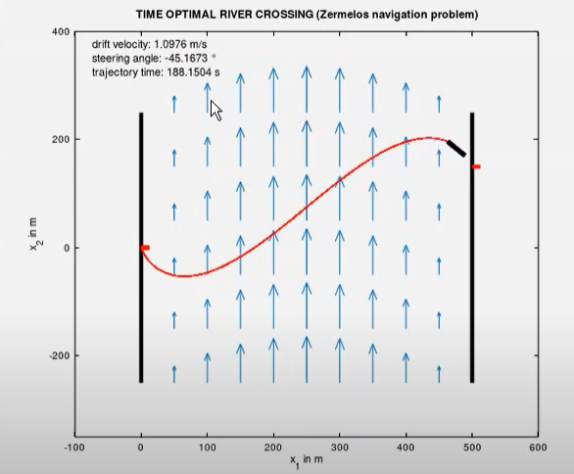
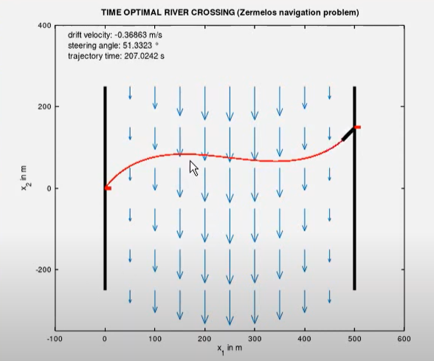
Zermelo’s Navigation Problem Conceptual Experiment
1) River Crossing
Case A (UpStream Flow )
Case B (Downstream Flow )
Motivation & literature review
Pagina 4
Notes:
4

Slide 5
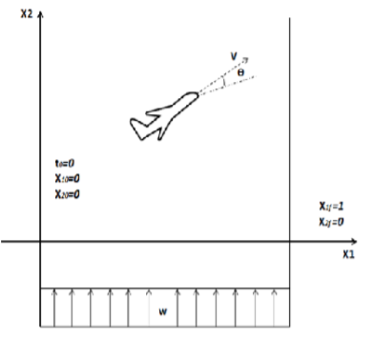
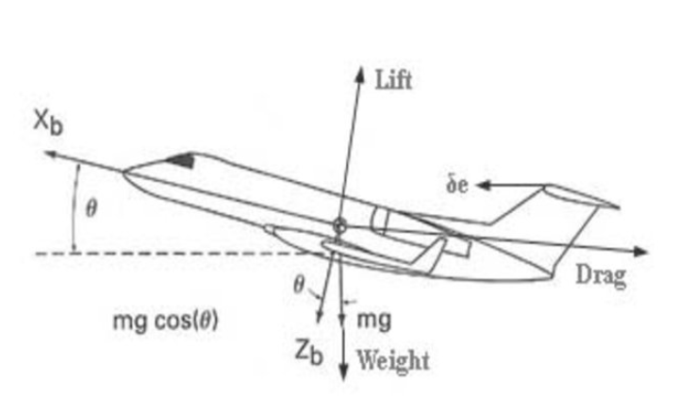
Zermelo’s Navigation Problem Conceptual Experiment
2) Drone Navigation
Optimal path of aircrafts
Aircraft Control inputs
Our Investigation is how to obtain optimal path to travel from point A to B,C,E,F,D in a minimum time and follow the path while minimizing an objective function related to control inputs and Tracking the optimal path .
Motivation & literature review
Pagina 5
Notes:
5

Slide 6
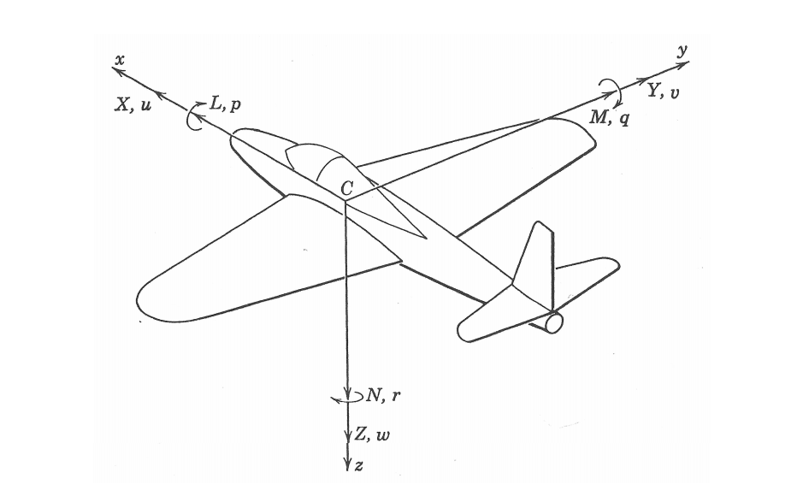
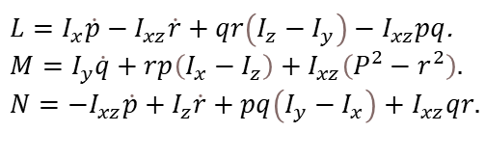
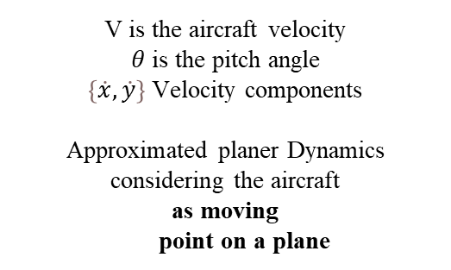
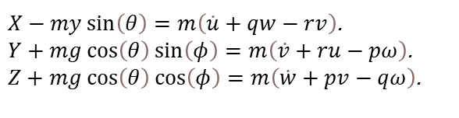
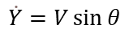
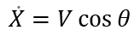
Model
Governing equations of the Aircraft Model
$$\dot{X}=V\cos{θ}$$
$$\dot{Y}=V\sin{θ}$$
V is the aircraft velocity $θ$is the pitch angle $\left\{\dot{x},\dot{y}\right\}$ Velocity components Approximated planer Dynamics considering the aircraft as moving point on a plane
$X−my\sin\left(θ\right)=m\left(\dot{u}+qw−rv\right)$. $Y+mg\cos\left(θ\right)\sin\left(φ\right)=m\left(\dot{v}+ru−pω\right)$.
$Z+mg\cos\left(θ\right)\cos\left(φ\right)=m\left(\dot{w}+pv−qω\right)$.
For the airplane is a rigid body with 6 degrees of freedom, Newton's second law of motion results in the following sets of equations
Forces
$L=I_{x}\dot{p}−I_{xz}\dot{r}+qr\left(I_{z}−I_{y}\right)−I_{xz}pq$.
$$M=I_{y}\dot{q}+rp\left(I_{x}−I_{z}\right)+I_{xz}\left(P^{2}−r^{2}\right).$$ $N=−I_{xz}\dot{p}+I_{z}\dot{r}+pq\left(I_{y}−I_{x}\right)+$ $I_{xz}qr.$
Moments
Model
Pagina 6
Notes:
6

Slide 7
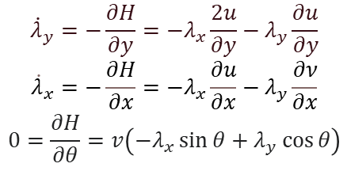
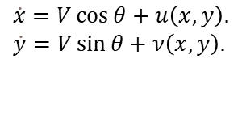

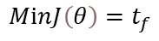
Zermelo’s Navigation Problem
Zermelo's Problem General Solution
$$\dot{x}=V\cos{θ}+u\left(x,y\right). \\ \dot{y}=V\sin{θ}+ν\left(x,y\right).$$
$$MⅈnJ\left(θ\right)=t_{f}$$
Objective function
$$\dot{x}=V\cos{θ}+u\left(x,y\right). \\ \dot{y}=V\sin{θ}+ν\left(x,y\right).$$
Where $θ denotes the control variable$
The Hamiltonian System is
$$H=λ_{x}\left(V\cos{θ}+u\right)+λ_{y}\left(Vsinθ+ν\right)+1.$$
And the adjoint equations are the follows :
$${\dot{λ}}_{y}=−\frac{∂H}{∂y}=−λ_{x}\frac{2u}{∂y}−λ_{y}\frac{∂u}{∂y}$$
$${\dot{λ}}_{x}=−\frac{∂H}{∂x}=−λ_{x}\frac{∂u}{∂x}−λ_{y}\frac{∂ν}{∂x}$$
$$0=\frac{∂H}{∂θ}=v\left(−λ_{x}\sin{θ}+λ_{y}\cos{θ}\right)$$
Zermelo’s Problem
Pagina 7
Notes:
7

Slide 8
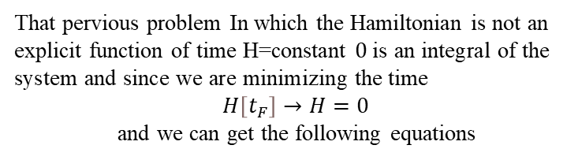
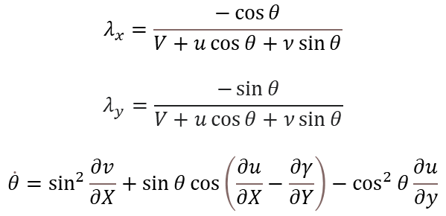
Zermelo’s Navigation Problem
Zermelo's Problem General Solution
That pervious problem In which the Hamiltonian is not an explicit function of time H=constant $0 \text{is} \text{an} \text{integral} \text{of} \text{the} \text{system} \text{and} \text{since} \text{we} \text{are} \text{minimizing} \text{the} \text{time}$ $$H\left[t_{F}\right]→H=0$$ and we can get the following equations
$$λ_{x}=\frac{−\cos{θ}}{V+u\cos{θ}+ν\sin{θ}}$$
$$λ_{y}=\frac{−\sin{θ}}{V+u\cos{θ}+ν\sin{θ}}$$
$$\dot{θ}=\sin^{2}{\frac{∂v}{∂X}}+\sin{θ\cos\left(\frac{∂u}{∂X}−\frac{∂γ}{∂Y}\right)}−\cos^{2}{θ\frac{∂u}{∂y}}$$
General solution of Zermelo’s problem
It is obvious that the $θ$ is strongly dependent on the wind direction
Zermelo’s Problem
Pagina 8
Notes:
8

Slide 9
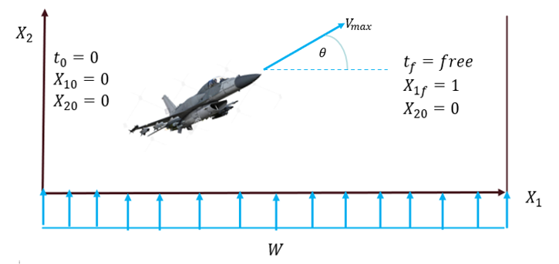
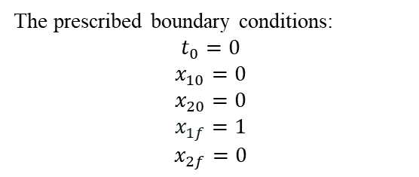
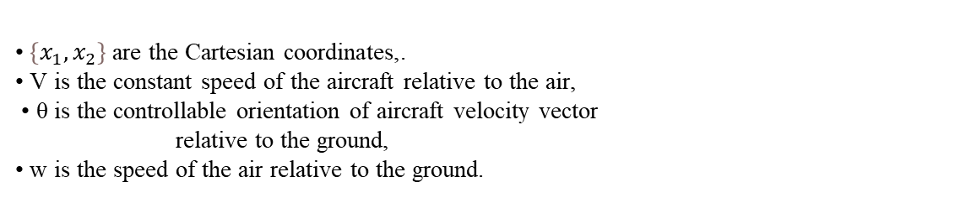
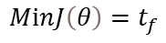
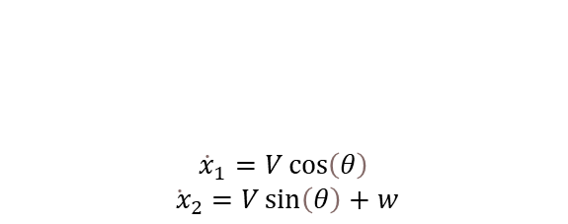
Zermelo’s Navigation Problem
First Case Study (constant wind from below)
$${\dot{x}}_{1}=V\cos\left(θ\right)$$ ${\dot{ x}}_{2}=V\sin\left(θ\right)+w$
$$MⅈnJ\left(θ\right)=t_{f}$$
Objective function
Dynamical constrains
• $\left\{x_{1},x_{2}\right\}$ are the Cartesian coordinates,.
• V is the constant speed of the aircraft relative to the air,
• θ is the controllable orientation of aircraft velocity vector relative to the ground,
• w is the speed of the air relative to the ground.
The prescribed boundary conditions: $$t_{0}=0$$
$$x_{10}=0$$
$$x_{20}=0$$
$$x_{1f}=1$$
$$x_{2f}=0$$
Zermelo’s Problem
Pagina 9
Notes:
9

Slide 10
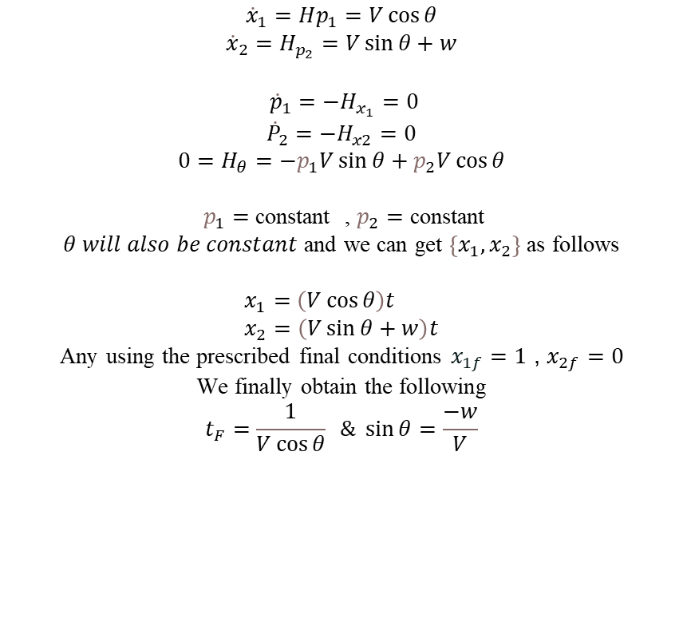
Zermelo’s Navigation Problem
The Hamiltonian Equation
$$H=p_{1}\left(Vcos\right)+p_{2}\left(V\sin{θ}+w\right)−1$$
The Euler Lagrange Equation Leads to
$${\dot{x}}_{1}=Hp_{1}=V\cos{θ}$$
$${\dot{x}}_{2}=H_{p_{2}}=V\sin{θ}+w$$ ${\dot{p}}_{1}=−H_{x_{1}}=0$
$${\dot{P}}_{2}=−H_{x2}=0$$
$$0=H_{θ}=−p_{1}V\sin{θ}+p_{2}V\cos{θ}$$
$p_{1}=$ constant , $p_{2}=$ constant $θ will also be constant$ and we can get $\left\{x_{1},x_{2}\right\}$ as follows
$$x_{1}=\left(V\cos{θ}\right)t \\ x_{2}=\left(V\sin{θ}+w\right)t$$
Any using the prescribed final conditions $x_{1f}=1$ , $x_{2f}=0$
We finally obtain the following
$$t_{F}=\frac{1}{V\cos{θ}} \& \sin{θ}=\frac{−w}{V}$$
Zermelo’s Problem
Pagina 10
Notes:
10

Slide 11
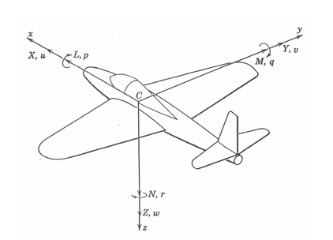

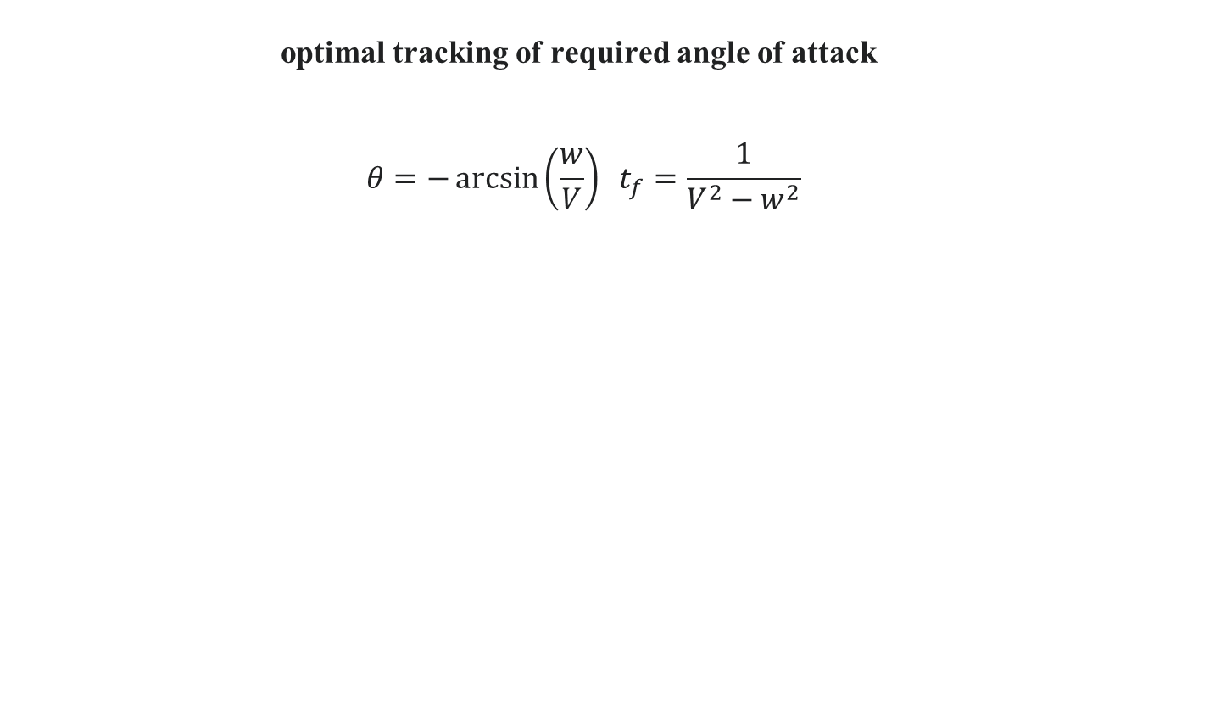
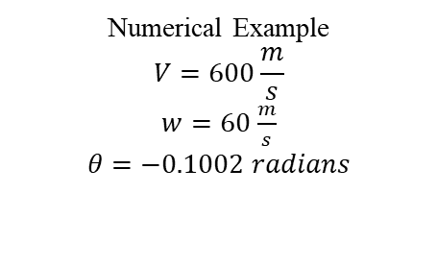


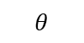

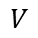
Zermelo’s Navigation Problem
optimal tracking of required angle of attack $$θ=−\arcsin\left(\frac{w}{V}\right) t_{f}=\frac{1}{V^{2}−w^{2}}$$
Our final solution
$$H_{θθ}=\frac{V^{2}}{V^{2}−w^{2}} >0$$
Numerical Example $$V=600\frac{m}{s}$$ $w=60$ $\frac{m}{s}$ $$θ=−0.1002 radians$$
$$V$$
$$−w$$
Upcoming Wind Field
$$θ$$
Optimal pitch angle
$$\sqrt{V^{2}−w^{2}}$$
Control Triangle
Our investigation is to show how we can zoom in and make the aircraft follow the our Zermelo’s output of Pitch Angle and if yes how do we can do that optimally with respect to an objective function related to control inputs and tracking this optimal path
Least control input to fly trought the wind while tracking the optimal pitch angle
Zermelo’s Problem
Pagina 11
Notes:
11

Slide 12
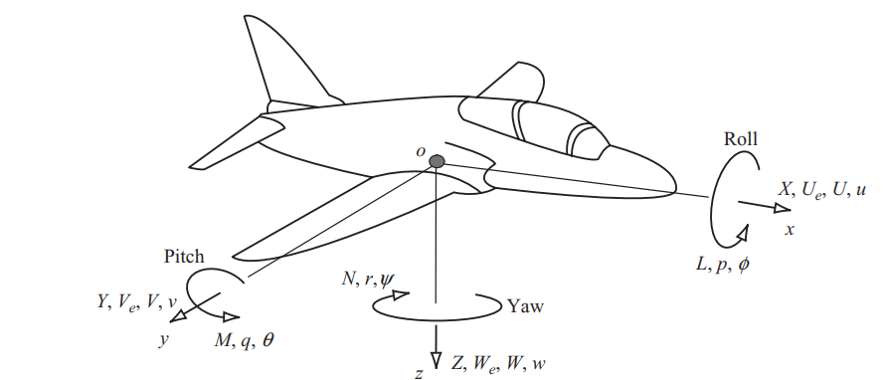
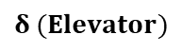
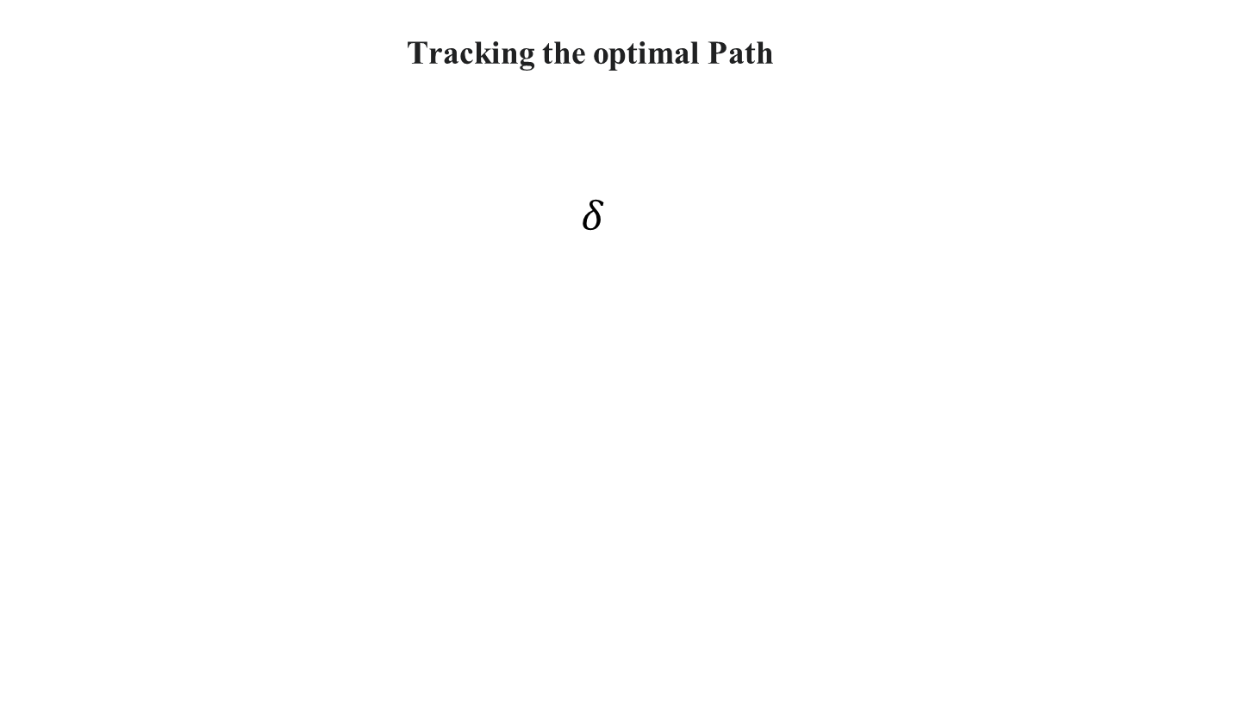
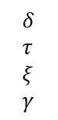
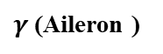
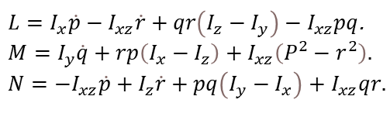
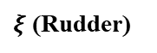
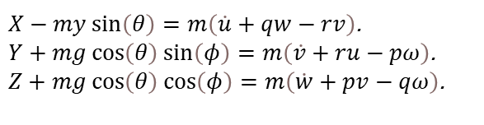
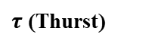
Optimal Tracking scheme
Tracking the optimal Path $$δ$$
$ξ$ (Rudder)
$γ$(Aileron )
$$δ (Elevator)$$
$τ$ (Thurst)
Control input
X Y Z L M N
$X−my\sin\left(θ\right)=m\left(\dot{u}+qw−rv\right)$. $Y+mg\cos\left(θ\right)\sin\left(φ\right)=m\left(\dot{v}+ru−pω\right)$.
$Z+mg\cos\left(θ\right)\cos\left(φ\right)=m\left(\dot{w}+pv−qω\right)$.
u v w r p q
$$δ \\ τ \\ ξ \\ γ$$
Black box of Aerodynamic modeling
$L=I_{x}\dot{p}−I_{xz}\dot{r}+qr\left(I_{z}−I_{y}\right)−I_{xz}pq$.
$$M=I_{y}\dot{q}+rp\left(I_{x}−I_{z}\right)+I_{xz}\left(P^{2}−r^{2}\right).$$ $N=−I_{xz}\dot{p}+I_{z}\dot{r}+pq\left(I_{y}−I_{x}\right)+$ $I_{xz}qr.$
Converting the control input to the aerodynamic forces (X,Y,Z,L,M,N) to be applied to the newton laws is the black box of aerodynamic modeling and through linearization of the equation around the aircraft equilibrium point we got the following model
longitudinal model of aircraft
Pagina 12
Notes:
12

Slide 13
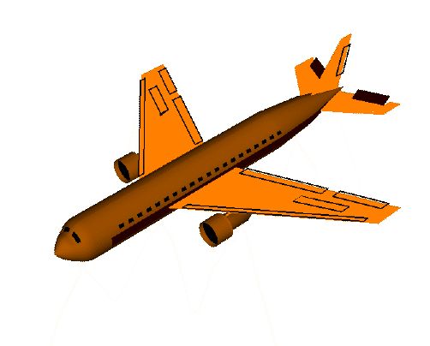
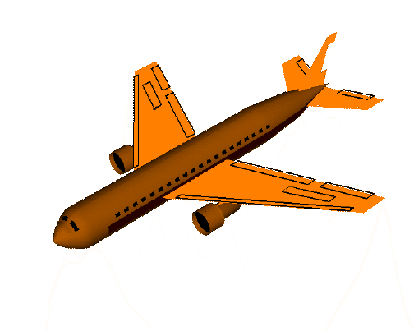
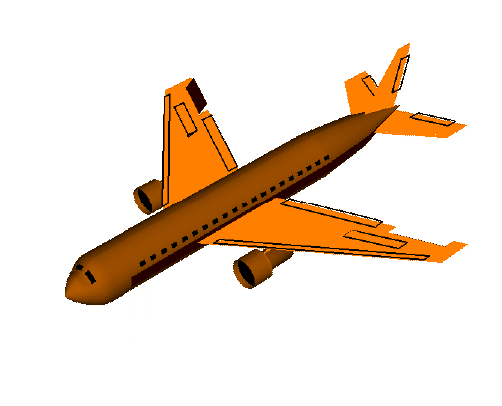
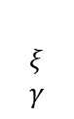
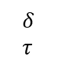
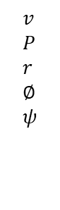
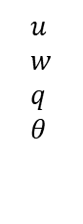
Optimal Tracking scheme
Dynamic Decoupling
Input Variables
Output Variables
$$u \\ w \\ q \\ θ$$
Longitudinal
$$δ \\ τ$$
Mathematical Model of Aircraft Dynamics
$$ξ \\ γ$$
Lateral & Directional
$$v \\ P \\ r \\ ∅ \\ ψ$$
Longitudinal
Directional
Lateral
longitudinal model of aircraft

Slide 14
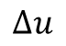
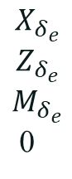
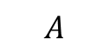
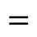

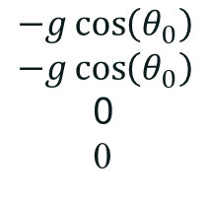
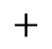













Optimal Tracking scheme
longitudinal dynamics Small disturbance theory
Elevator
$$Δ\dot{u}$$
$$Δ\dot{w}$$
$$Δ\dot{q}$$
$$Δ\dot{θ}$$
$$X_{u}$$
$$Z_{u}$$
$$M_{u}$$
0
$$X_{w}$$
$$Z_{w}$$
$$M_{w}$$
0
$$X_{q}+w_{o}$$
${ Z}_{q}−$ $w_{o}$
$$M_{q}$$
1
$$−g\cos\left(θ_{0}\right)$$
$$−g\cos\left(θ_{0}\right)$$
0
0
$$Δu$$
$$X_{δ_{e}}$$
$$Z_{δ_{e}}$$
$$M_{δ_{e}}$$
0
$$δ_{T}$$
0
0
0
$$=$$
$$Δw$$
$$+$$
$$Δδ_{e}$$
$$Δq$$
$$Δδ_{T}$$
$$Δu$$
Thrust
$$\dot{X}$$
$$A$$
$$X$$
$$B$$
$$u$$
Aerodynamic coefficients are constant as result of linearization around the equilibrium point and they depend only the aircraft geometry
NEXT we will analysis this linear time invariant system
longitudinal model of aircraft

Slide 15


Optimal Tracking scheme
Typical Stable open loop Response of Civil Aircrafts
longitudinal model of aircraft

Slide 16



Optimal Tracking scheme
Assumptions and Model
We write our linear model here
$\left[\begin{matrix}\dot{θ} \\ \dot{α} \\ \dot{q}\end{matrix}\right]=\left[\begin{matrix}0 & 0 & 1 \\ −1.1714∗{10}^{−13} & −0.76788 & 0.9396 \\ 0 & −2.251 & −1.0462\end{matrix}\right]\left[\begin{matrix}θ \\ α \\ q\end{matrix}\right]+\left[\begin{matrix}0 \\ −0.0016222 \\ −0.16416\end{matrix}\right]δ_{ε}$. $$θ=\left[1 0 0\right]∗\left[\begin{aligned}θ \\ α \\ q\end{aligned}\right]+\left[0\right]δ_{ε}$$
$$T\left(s\right)=\frac{−0.1642 S−0.1224}{S^{3}+1.8414 S^{2}}$$
$$P_{1,2}=−0.9070±1.4476j \\ P_{2}=0$$
State Variable | Trimming Value
Pitch Angle $θ$ | 0.046492 deg
Angle of Attack $α$ | 0.046492 deg
Pitch Rate q | 0 m/$s^{}$
Longitudinal Speed V | 600 m/s
longitudinal model of aircraft

Slide 17


Optimal Tracking scheme
Typical Stable open loop Response of F16 Fighter
Relaxed Static Stability of the F16 design
longitudinal model of aircraft

Slide 18


Optimal Tracking scheme
The proposed Scheme
Optimal Desired Pitch Angle
The goal of our proposed scheme to find the optimal path against wind and based on Zermelo’s Based Optimizer and enforce the aircraft to follow that path optimally with respect to Objective Function
Proposed Navigation Scheme

Slide 19
Results & Simulations
Required Performance Specifications
Stabilize the closed loop dynamics
FAST MANOUVER 10% overshoot, sett. time less 0.5 s
SLOW MANOUVER 0% overshoot Sett. time less 2.0 s
How ?
In which we will apply two control methods
Pole Placement Method
Linear Quadratic Regulator
Results & Simulations

Slide 20

Results & Simulations
Pole Placement Method
The idea behind this method is to determine the value of the gain K in order to place the poles of the closed loop system in specific locations We have chosen these values for the poles:
$p_{1}=−2+0.4j$
$p_{2}=−2−0.4j$
$p_{3}=−6$
And these are the respective gains:
${K′}_{1}=\left(\begin{aligned}203.9156 \\ 92.6561 \\ −50.7811\end{aligned}\right)$
$G_{1}=−203.9156$
Results & Simulations

Slide 21

Results & Simulations
Pole Placement Method results
Performance Specifications | Values
Rise Time | 0.3335 s
Overshoot | 34.6232 %
Settling Time | 3.1880 s
Peak Time | 0.9978 s
Results & Simulations

Slide 22

Results & Simulations
Linear Quadratic Regulator
Considering the following linear time invariant system
$$\dot{X}\left(t\right)=AX+Bu$$
$$Y=CX$$
with initial conditions $x\left(t_{i}\right)=x^{i}$ representing the trimmed conditions of the aircraft where A, B, C are constant Matrices of dimensions $3×3$ , $3×1$ and $1×3$ respectively and they depends only on the Aircraft Geometry. the quadratic cost function is $J\left(x,u\right)=\frac{1}{2}\int_{t_{o}}^{t_{f}}{\left( {\left(r\left(t\right)−x\left(t\right)\right)}^{T}Q(r\left(t\right)−x\left(t\right))+U^{T}RU\right)dt},$ where - Q is nonnegative symmetric matric the values of the diagonal element represent the weight of each state. - R is a positive definite Matrix represent the weight of the controller To find the optimal gain $U^{0}ε {\overline{C}}^{1}[t_{i},t_{f}]$ we need to solve the algebraic Riccati’s equation shown in equation below. $0=KBR^{−1}B^{T}−KA−A^{T}K−Q.$ $\text{In} \text{which} \text{it} \text{admits} \text{a} \text{unique} \text{solution} \text{in} \text{the} \text{form} \text{of} \text{a} \text{linear} \text{feedback} \text{Law} \text{as} \text{the} \text{following}$
$$U^{0}\left(t\right)=−R^{−1}B^{T}KX^{0}$$
Results & Simulations

Slide 23


Results & Simulations
Linear Quadratic Regulator
Considering the following choice for Q and R matrices
$$Q_{1}=\left(\begin{matrix}90 & 0 & 0 \\ 0 & 0 & 0 \\ 0 & 0 & 0\end{matrix}\right)$$
$$R_{1}=0.0001$$
We will get the following gain and pre compensator matrix
$K_{1}=\left(\begin{aligned}−948.6833 \\ 13.5169 \\ −100.7071\end{aligned}\right)$
$$G_{1}=−948.6833$$
Performance Specifications | Values
Rise Time | 0.1714 s
Overshoot | 4.4374 %
Settling Time | 0.4777 s
Peak Time | 0.3566 s
Results & Simulations

Slide 24


Results & Simulations
Linear Quadratic Regulator
Considnering the following Choice of Q and R Matrice
$Q_{2}=\left(\begin{matrix}90 & 0 & o \\ 0 & 0 & 0 \\ 0 & 0 & 15\end{matrix}\right)$
$$R_{2}=0.0001$$
We will get the following gain and pre compensator Matrix
$$K_{2}=\left(\begin{aligned}−948.6833 \\ 13.5512 \\ −395.4273\end{aligned}\right)$$
$$G_{2}=−948.6833$$
Performance Specifications | Values
Rise Time | 0.8968 s
Overshoot | 0 %
Settling Time | 1.6129 s
Peak Time | 2.9852 s
Results & Simulations

Slide 25


Results & Simulations
State Evolution in the Case of Linear Quadratic Regulator
State Evolutions using LQR with Q1 and R1
State Evolutions using LQR with Q2 and R2
Results & Simulations

Slide 26




Results & Simulations
Minimizing the control action using LQR with different value of R
$$r_{1}$$ | $$r_{2}$$ | $$r_{3}$$
5 | 10 | 15
Where the green line represents $r_{3}$ ,the blue line represents $r_{2}$ and the black line represents the $r_{1}$
Results & Simulations

Slide 27



Results & Simulations
Tracking of Optimal Pitch Angle
using LQR with Q3 & R3 and Bounded Control
$$Q_{3}=\left(\begin{matrix}900 & 0 & o \\ 0 & 0 & 0 \\ 0 & 0 & 9\end{matrix}\right)$$
$$R_{3}=0.1$$
We Obtain:
$$K_{4}^{′}=\left(\begin{aligned}−94.8683 \\ 12.0903 \\ −27.5126\end{aligned}\right)$$
$$G_{4}=−94.8683$$
Results & Simulations

Slide 28



Results & Simulations
Tracking of Optimal Pitch Angle
using LQR with Q3 & R3 and Bounded Control
$$\left|u\left(t\right)\right|≤25 deg (34)$$
$$q\left(t\right)≤60 \frac{deg}{s} (35)$$
Results & Simulations

Slide 29
Conclusions & Future work
To sum up, by solving two optimal control problems we found and tracked the best pitch angle for an aircraft flying in a constant upwind condition. We decide to compare two different control schemes which are Pole Placement and LQR. After having set overshoot and settling time of the pitch angle as two different performance objectives, we finally proved that LQR is the best controller since it satisfied the objectives that we set.
It could also be interesting to consider other variations to our project. The way the model is constructed in our case of study could also be deepened. Instead of studying the flight of an aircraft in a constant wind situation and with unbounded control for the elevator deflection, we could also consider a variable wind along multiple directions, that implies the resolution of Zermelo’s problem in more general case, and the use of Pontryagin’s Principle to obtain the control law.
Conclusions and Future Work

Slide 30
References
1] Aysha S. Hameed, Al Bilal. N., Mukund A. R., Ansha S., Comparison of Aircraft Pitch Control using Pole Placement and LQR, International Journal of Advanced Research in Electrical, Electronics and Instrumentation Engineering, available at: http://www.ijareeie.com/upload/2019/june/4_Comparison.pdf
[2] Kahina Louadj, Pierre Spiteri, Fethi Demim, Mohamed Aidene, Abdelkrim Nemra and Frédéric Messine, Application Optimal Control for a Problem Aircraft Flight, Journal of Engineering Science and Technology Review 11 (1)(2018) 156-164, available at:
https://www.researchgate.net/publication/323887316_Application_Optimal_Control_for_a_Problem_Aircraft_Flight
[3] Sivaram Wijenddra, Manuel Vergara and Gunneet Singh, Autopilot Design for an F16 Fighter Aircraft, available at: https://users.encs.concordia.ca/~ymzhang/courses/MECH480-6091/CourseProjects&Labs/MECH6091/F2011/MECH6091_Presentation_Group2.pdf.
[4] Michael Cook, Flight Dynamic Principles, Butterworth-Heinemann.
[5] Daniel Liberzon, Calculus of Variations and Optimal Control Theory: A Concise Introduction, Princeton University Press.
References

